Slide 1

Palliative and End of Life Care

Slide 2
The facts
As a result of the UK’s aging population, the number of deaths per year is expected to rise by 17% between 2012 and 2030
Many more people will be dying at an older age and therefore more likely to have complex needs and multiple co-morbidities as they near the end of their lives.

Slide 3
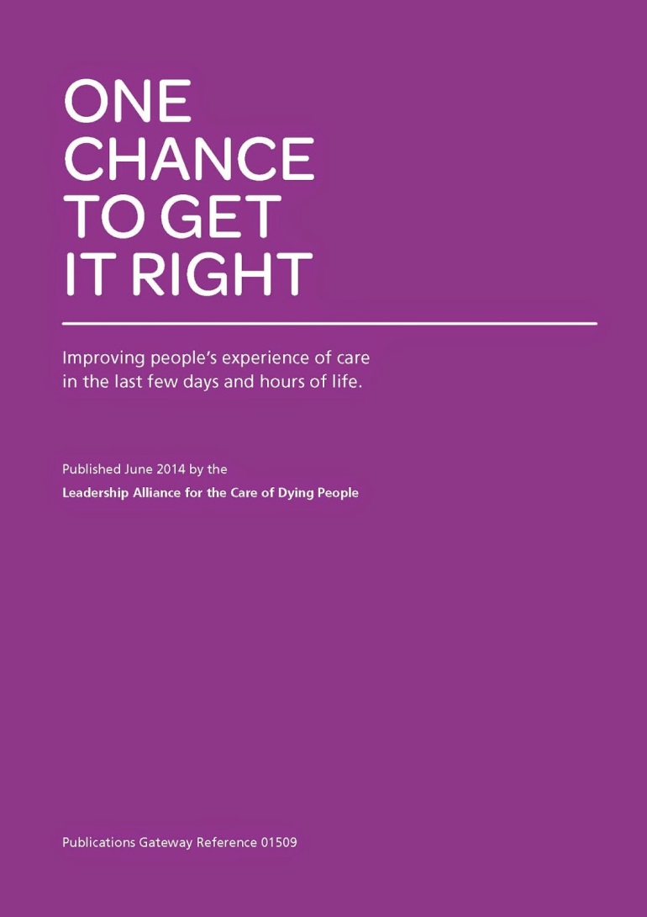
‘One Chance to Get it Right’
5 Priorities for End of Life Care
(Leadership Alliance for the care of Dying People, 2014)
That dying was recognised (diagnosed)
Communication with the patient and family / significant others
Involvement of the family / carers (decisions)
Family needs identified
An individual care plan was used to support care

Slide 4
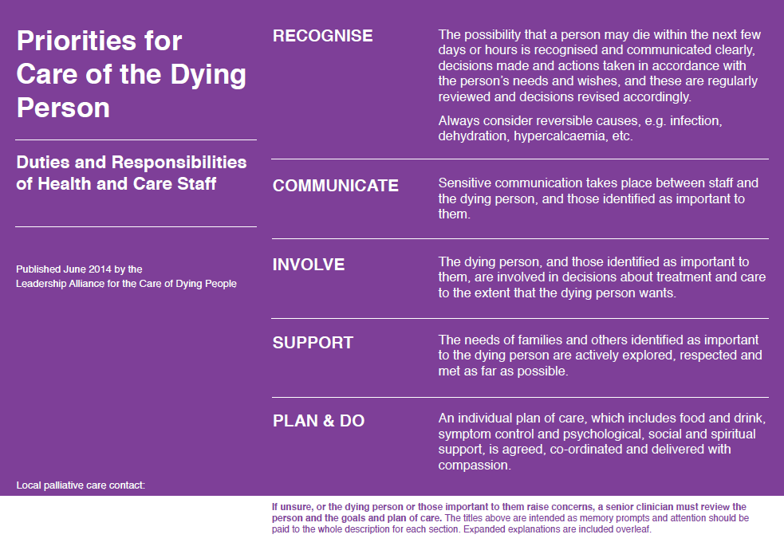

Slide 5
‘Care of the Dying Patient Care plan’
(Supporting care in the last hours or days of life)
As with all clinical guidelines and care plans the Bedfordshire
Hospitals Care of the Dying care plan aims to support not replace clinical judgment
To ensure that we do all we can at Bedfordshire Hospitals to make sure that our patients (and their families) receive the best care in the last hours/days of life we have a care plan which replaces all other documents/paperwork. All Observations and investigations are stopped and care is focused on their comfort.

Slide 6
Local Palliative Care Services and Support
Hospital Team-7 day service ( both sites)
2 Consultants, 1 Specialist Registrar, 5 Clinical Nurse Specialists (CNS), 1 Practice Development Nurse (PDN) ( Bedford site)
1 Consultant, 3 Clinical Nurse Specialists Palliative Care, 2 End of life Care Nurses ( Luton site)
We work closely with:
Hospice Team (St Johns Hospice/ Willen Hospice MK, Keech Hospice)
Community Team (Community Macmillan)
Out of Hours support (St Johns Hospice, Palliative Care Hub, Mycare coordination team, Oncology services, especially the acute oncology service (AOS) team
Other specialist teams including Site specific CNS’s/Dieticians/Physios/OTs/Chaplaincy/Discharge planners etc…

Slide 7
And Finally:
‘’Death and dying are inevitable. Palliative and end of life care must be a priority.
The quality and accessibility of this care will affect all of us and it must be made consistently better for all of us.
The needs of people of all ages who are living with dying, death and bereavement, their families, carers and communities must be addressed, taking into account their priorities, preferences and wishes’’.
(National Palliative and End of Life Care Partnership, 2015)

